Slide 1


Project 9：Monocular Depth Estimation via Transfer Learning
Supervisor: Yongbo Chen
Group Members 9d:
Weihao Xuan, Ruijie Ren, Siyuan Wu, Liangchen Sui, Shaohang Han

Slide 2
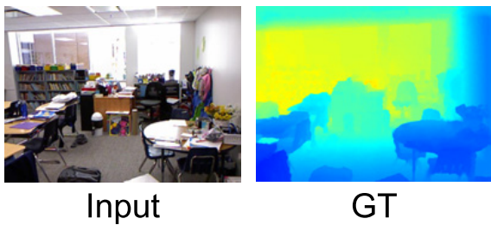
Project 9：Monocular Depth Estimation via Transfer Learning
Task Description:
Pixel to pixel regression
Far Pixel
Near Pixel

Slide 3
Project 9：Monocular Depth Estimation via Transfer Learning
Encoder & Decoder Design:
Encoder
Backbone of DenseNet-169 transferred from ImageNet classification
Decoder
Successive bilinear upsampling blocks followed by shallow convolutional layers to realize pixel-pixel regression(high complexity proved to backfire)
1x1 Convs to establish inter-channel connections
Skip connections to retrieve information and add high-resolution details

Slide 4
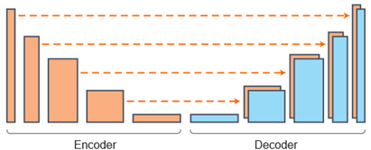
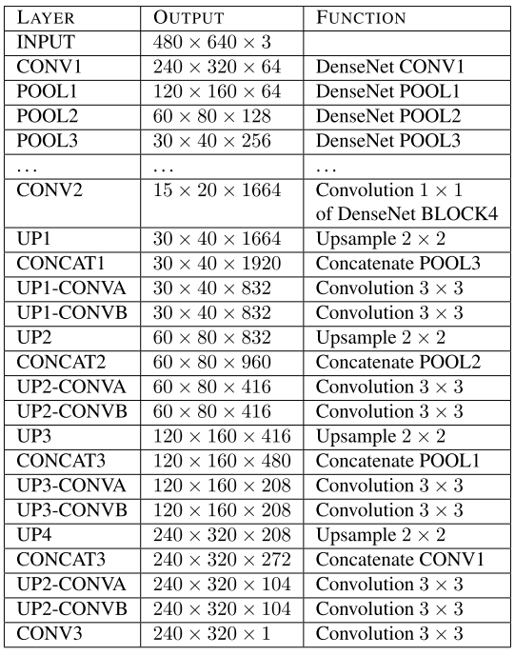
Project 9：Monocular Depth Estimation via Transfer Learning
Encoder & Decoder Design:
Encoder
Decoder

Slide 5
Project 9：Monocular Depth Estimation via Transfer Learning
Loss Function Design
L1 Loss(Depth + Gradient) + SSIM ➔ High Granularity
L2 Loss(Depth + Gradient) + SSIM ➔ Fast Convergence
Berhu Loss(Depth + Gradient) + SSIM ➔ Make a Compromise

Slide 6
Project 9：Monocular Depth Estimation via Transfer Learning
Data Augmentation
To achieve higher generalizations, series of operations simulating natural deformations are implemented on the dataset
Random crops
Horizontal flips
Vertical flips
Rotations
Affine transformations

Slide 7
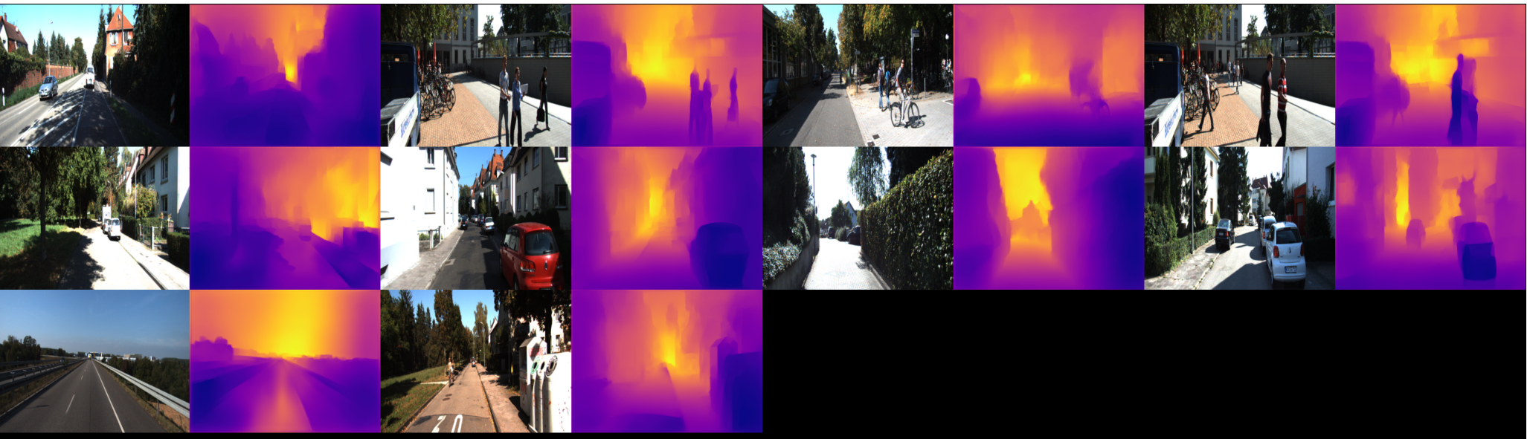
Project 9：Monocular Depth Estimation via Transfer Learning
Results
RGB Inputs & Depth Predictions(fine-tunned on KITTI)
Evaluation metrics are regretfully not available due to the key files missing in the benchmark

Slide 8
Project 9：Monocular Depth Estimation via Transfer Learning
Future Work
An interesting discovery: specific scenarios such as outdoors and over exposures are not considerately collected in NYU Depth v2 dataset, which could jeopardize the robustness and generalization of the model under some extreme circumstances, especially when the depth values are large and light intensities are high.

Slide 9
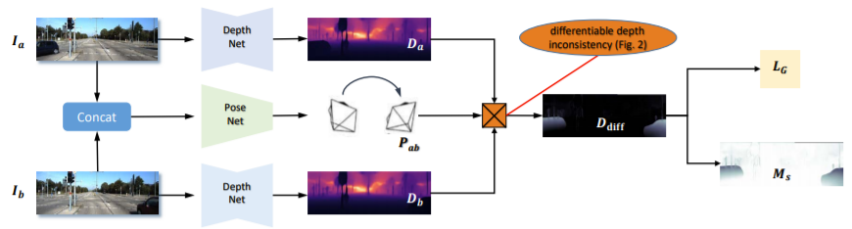
Project 9：Monocular Depth Estimation via Transfer Learning
Future Work
The structure of ideal model based on supervised learning could be used as Depth Net component in unsupervised scale-consistent depth learning from video, which tends to serve as an important part in visual SLAM to provide depth information.

Slide 10
Thank you for listening!
Reference: High Quality Monocular Depth Estimation via Transfer Learning

